Slide 1
CSE 109 Electrical Circuits
Dr. Md. Forkan Uddin
Associate Professor
Department of Electrical and Electronic Engineering (EEE)
Bangladesh University of Engineering and Technology (BUET)

Slide 2
AC Circuits: RMS/Average (Chapter 3 – Corcoran)

Slide 3
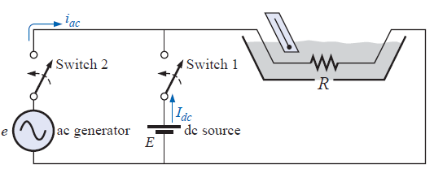
Effective or RMS Value
Average rate of heat production over a cycle of alternating current (AC):
Average rate of heat production by a direct current (DC):
Effective value / Root Mean Square (RMS) value
Denoted bi: I_{rms} or I_{eff}
Thus,

Slide 4
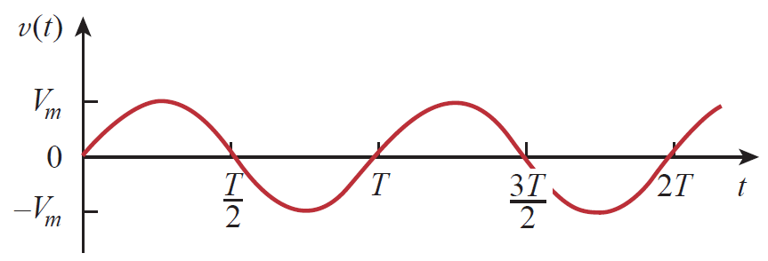
RMS Value: Sinusoidal Signals
Proof need to be studied from class lecture

Slide 5
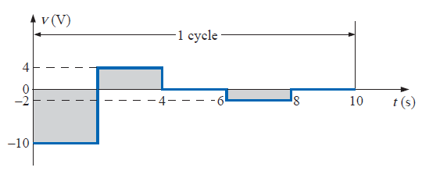


RMS Value: Non-sinusoidal Signals

Slide 6
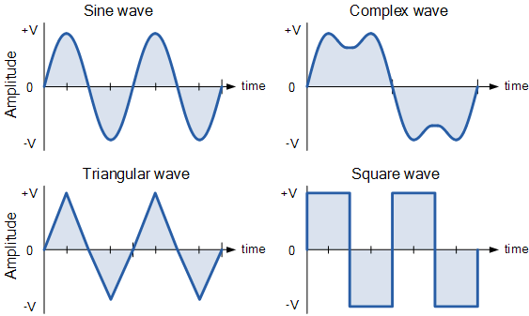
Average Value
Alternating waveforms
Average over an integer number of cycle = 0 (zero)

Slide 7
Average Value: Sinusoidal Waveforms
Average over an integer number of cycle = 0 (zero)
Average over half-cycle:
Proof need to be studied from class lecture

Slide 8
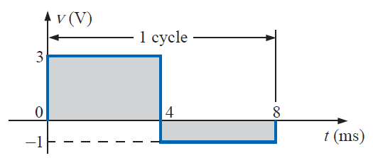

Average Value: Non-AC Waves
V_{avg}

Slide 9
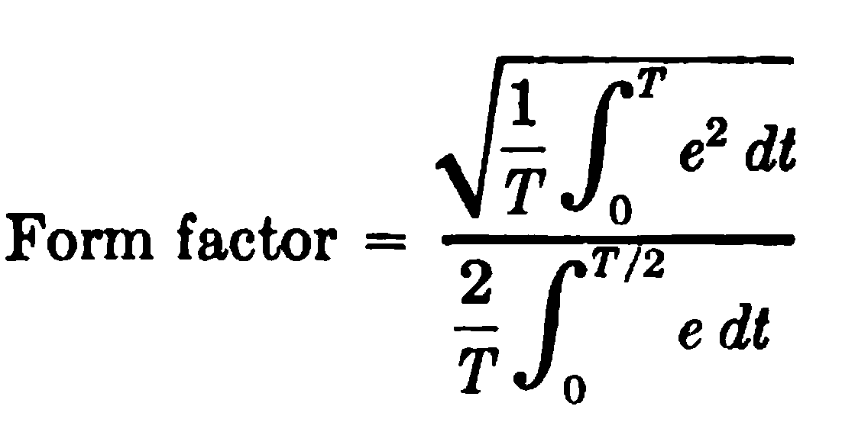
Form Factor and Crest Factor
For sinusoidal AC wave: Form Factor = 1.11
For sinusoidal AC wave: Crest Factor = √2 = 1.414

Slide 10
Power
Real Power:
Reactive Power:
Volt-Ampere:
VA
Q
Power Factor (p.f.):
θ
P

